Slide 1
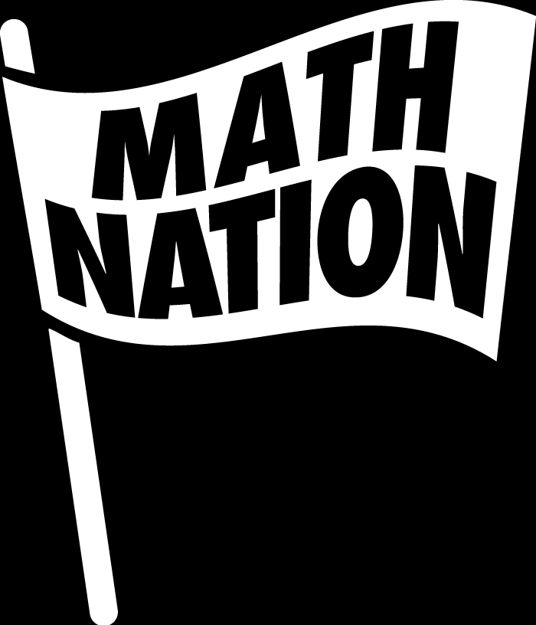
6th Grade Math
Unit 9, Lesson 4 Finding and Interpreting Median, Mode, and Range Volume 2, pg. 160

Slide 2


Benchmark
MA.6.DP.1.2
Given a numerical data set within a real-world context, find and interpret mean, median, mode, and range.
volume 2, pg. 160

Slide 3
Integrated Mathematical Thinking and Reasoning Standards
MA.K12.MTR.4.1 Engage in discussions that reflect on the mathematical thinking of self and others.
MA.K12.MTR.7.1 Apply mathematics to real-world contexts.
volume 2, pg. 160

Slide 4

Learning Targets
I can find the mean, median, mode, and range of a given data set.
I can interpret the median, mode, and range of a given data set.
volume 2, pg. 160

Slide 5

Warm-Up
volume 2, pg. 160

Slide 6
9.4.1 Warm-Up: Notice and Wonder
The diagram below shows bar charts for the median and mean income between 2012 and 2014 in selected countries. The income is given in U.S. dollars ($).
volume 2, pg. 160

Slide 7
What do you notice about the values for median and mean income?
What do you wonder about the values for median and mean income?
volume 2, pg. 160

Slide 8

Guided Instruction
volume 2, pg. 161

Slide 9

9.4.2 Guided Instruction: Mean, Median and Mode
For each definition, fill in the blank with one of the words from the bank.
median | mode
mean | range
The ___________ is the arithmetic average of a set of numbers. It is a measure of central tendency.
The ___________ is the difference between the highest data value and the lowest data value in a data set. It is a measure of variation.
volume 2, pg. 161

Slide 10
median | mode
mean | range
The ___________ is the value found most often in a set of numbers. There may be no, one, or more than one __________ in the data set. It is a measure of central tendency.
The ___________ is the middle of an ordered list of the values. If the list has an odd number of values, it is the middle value of that list. If the list has an even number of values, it is the average of the two middle values. It is a measure of central tendency.
volume 2, pg. 161

Slide 11
The number of pets ten students in Tyler’s class have is reflected in the table.
Describe steps to find the median.
The median number of pets for the ten students is _________.
Number of Pets
1 | 0 | 2 | 1 | 10 | 0 | 2 | 0 | 8 | 12
volume 2, pg. 161

Slide 12
The mode of the data set is ____________.
Write an explanation of what the mode of the data set means for the context.
volume 2, pg. 161

Slide 13
Describe the steps needed to find the average number of pets owned by the ten students.
The mean number of pets for the ten students is __________.
Complete the statement about the mean of the data set.
“Each student in Tyler’s class has about _________ pets.”
volume 2, pg. 162

Slide 14

Try It
volume 2, pg. 162

Slide 15

9.4.3 Try It: Mean, Median, and Mode
Nine adults boarding a cruise ship at Port Canaveral in Florida were randomly surveyed on the total number of vacations they have taken in the last five years. Their totals are summarized below.
What does the value of the median represent in the context?
Number of Vacations Taken
5 | 4 | 3 | 9 | 1 | 4 | 0 | 6 | 3
volume 2, pg. 162

Slide 16
What is the median number of vacations taken by the adults surveyed?
Determine the mean of the data. Then, interpret the mean in terms of the context by writing a sentence to summarize. Round to the hundredths.
volume 2, pg. 162

Slide 17

Exploration
volume 2, pg. 163

Slide 18

9.4.4 Exploration: Understanding Mode and Range
Work with your partner to complete the following.
The is the value occurring most often in a set of data, which can be used to describe trends in data.
mean
median
mode
range
volume 2, pg. 163

Slide 19
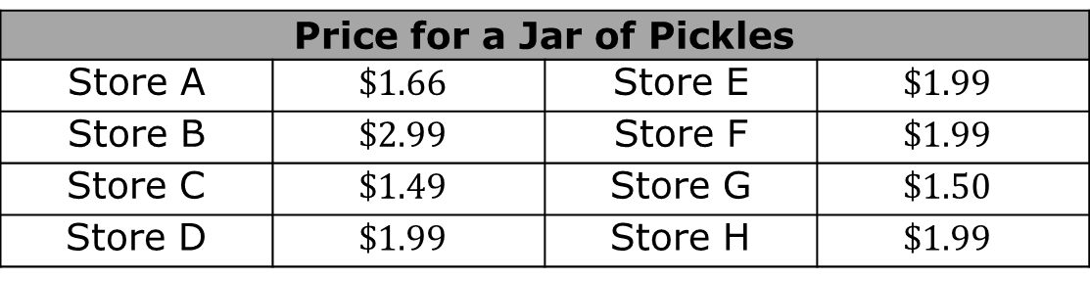
While shopping over the last month, Shep collected the price for a jar of pickles from eight stores he visited.
What does a jar of pickles cost at most stores?
This value is the
Price for a Jar of Pickles
Store A | $$\$1.66$$ | Store E | $$\$1.99$$
Store B | $$\$2.99$$ | Store F | $$\$1.99$$
Store C | $$\$1.49$$ | Store G | $$\$1.50$$
Store D | $$\$1.99$$ | Store H | $$\$1.99$$
median of the data set.
mode of the data set.
volume 2, pg. 163

Slide 20
What is the most Shep will spend on a jar of pickles?
What is the least Shep will spend on a jar of pickles?
The range of a data set describes how spread out the data is. Determine the range in price for a jar of pickles.
volume 2, pg. 163

Slide 21
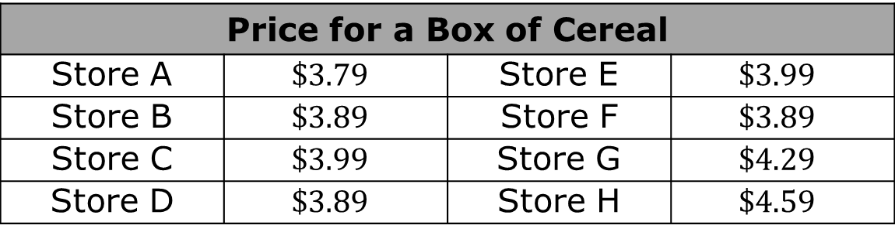
Shep also began collecting the price of his favorite cereal to determine where he would get the best price.
The mode price of his favorite box of cereal is _____________.
Price for a Box of Cereal
Store A | $$\$3.79$$ | Store E | $$\$3.99$$
Store B | $$\$3.89$$ | Store F | $$\$3.89$$
Store C | $$\$3.99$$ | Store G | $$\$4.29$$
Store D | $$\$3.89$$ | Store H | $$\$4.59$$
volume 2, pg. 163

Slide 22
What is the most Shep will spend on a box of cereal?
What is the least Shep will spend on a box of cereal?
The range for the price of a box of cereal is ______________.
volume 2, pg. 163 - 164

Slide 23
center
variability
The range describes the of the data set.
With your partner, discuss whether the price for pickles or the price for cereal has more variability in pricing. Summarize the discussion.
volume 2, pg. 164

Slide 24


Measures of variability are numerical values that measure how much a data set varies from a central value.
The range is a measure of variability. By comparing the ranges for two or more data sets, the data set that has more variability can be determined by finding which has a larger ___________.
volume 2, pg. 164

Slide 25

Collaboration
volume 2, pg. 164

Slide 26

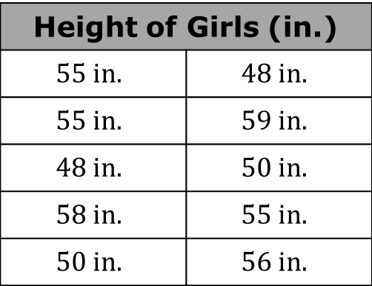
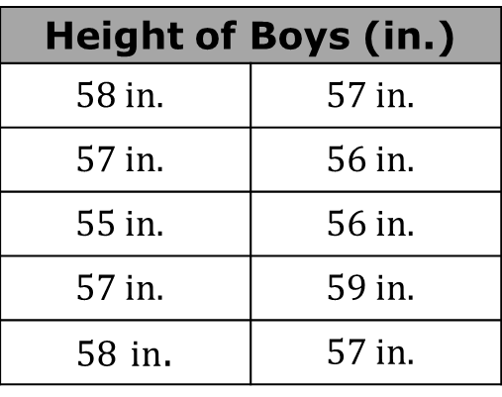
9.4.5 Collaboration: Analyzing Numerical Data
Alice collected data on the height of sixth graders in her school. Below are two tables with heights, in inches (in.), of some of her male and female classmates.
Height of Boys (in.)
$$58 in.$$ | $$57 in.$$
$$57 in.$$ | $$56 in.$$
$$55 in.$$ | $$56 in.$$
$$57 in.$$ | $$59 in.$$
$58$ $in$. | $$57 in.$$
Height of Girls (in.)
$$55 in.$$ | $$48 in.$$
$$55 in.$$ | $$59 in.$$
$$48 in.$$ | $$50 in.$$
$$58 in.$$ | $$55 in.$$
$$50 in.$$ | $$56 in.$$
volume 2, pg. 164

Slide 27
With your partner, determine who will be Partner A and who will be Partner B. Then, follow the directions.
Partner A: Use data from the height of ten boys to find the mean, median, and mode of the boys’ heights in Alice’s class. Then, write each value in the table.
Partner B: Use data from the height of ten girls to find the mean, median, and mode of the girls’ heights in Alice’s class. Then, write each value in the table.
volume 2, pg. 164

Slide 28
Share the values you calculated with your partner. Then, add the values your partner calculated into your table.
Write a statement in the table interpreting each mean and a statement interpreting each mode.
Compare your statements with your partner. If necessary, resolve any differences.
volume 2, pg. 165

Slide 29
Height of Boys (in.) |  | Height of Girls (in.)
Mean of boys’ heights |  | Mean of girls’ heights
Median of boys’ heights |  | Median of girls’ heights
Mode of boys’ heights |  | Mode of girls’ heights
Interpretation of the mean height of boys: |  | Interpretation of the mean height of girls:
Interpretation of the mode height of boys: |  | Interpretation of the mode height of girls:
volume 2, pg. 165

Slide 30
With your partner, determine the range of boys’ heights. Then, determine the range of girls’ heights.
Explain whether boys or girls in Alice’s class have more variability in their heights.
volume 2, pg. 165

Slide 31

Wrap-Up
volume 2, pg. 166

Slide 32
9.4.6 Wrap-Up: Reflection
Read each of the “I can” statements below. Check the boxes that best explain your understanding.
I can find and interpret the median, mode, and range of a given data set.
I understand how to find the mean, median, and mode of a data set.
I need support on how to find the mean, median, and mode of a data set.
I understand how to find the range of a data set.
I need support on how to find the range of a data set.
I understand how to interpret measures of central tendency.
I need support on how to interpret measures of central tendency.
volume 2, pg. 166

